Slide 1
Linux Introduction and basic commands
Name:Naikade Rohit Anand.

Slide 2
Assignment No.1
Date:11.09.2021

Slide 3
1.Print the system information and the Linux server release name.
Uname command is used to get system information in linux.if you use uname only,it will print kernel name of your system.
Common flags:
1.uname -n:prints network hostname.
2.uname -v:print kernel version.
3.uname -r:prints kernel release.
4.uname -m:print your machine hardware name.
lsb_release -a command is used to print current ubuntu version running on machine.

Slide 4
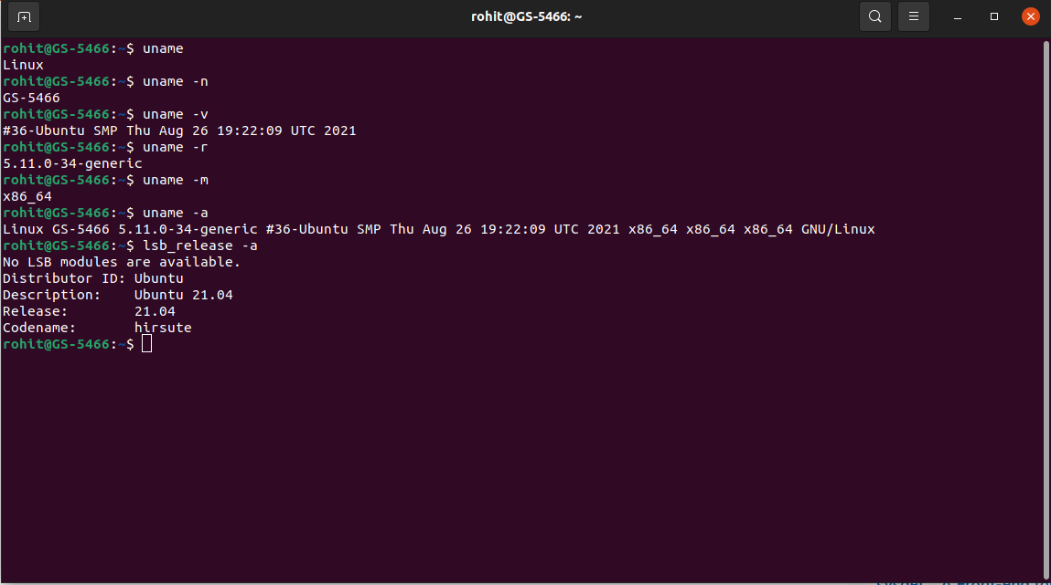

Slide 5
2. Display the user with which you’ve logged in
There are four linux commands to get info about current logged in user:
1.whoami:prints user name who is currently logged in.
2.who:prints current logged in user with logged in time.
3.w:print current logged in users with what they are doing.
4.id:prints current logged in user’s user id and group in information.

Slide 6
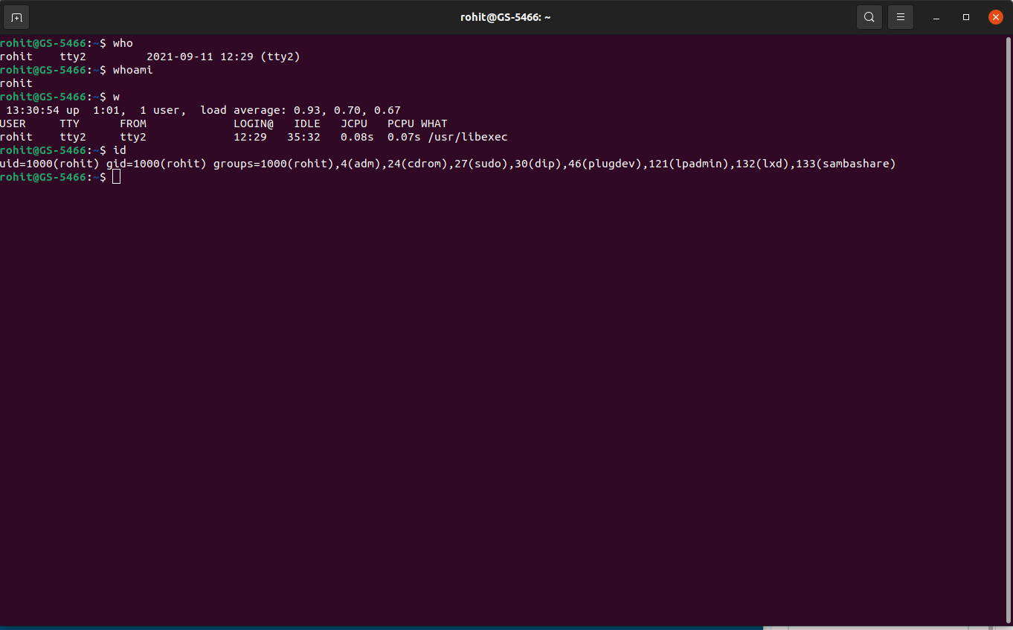

Slide 7
List all the files (including hidden files) in your home directory.
Ls command is used to list all files in a current directory.-l option provides additional information about files.
To show hidden files in a current directory,-a option is used.

Slide 8
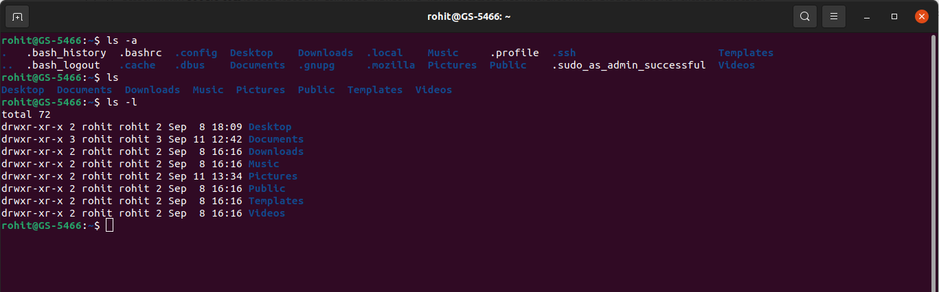

Slide 9
4.List the files in /boot in a human readable format.
Firstly,move to /boot using cd command.
To print list of files in human readable format,use -h option

Slide 10
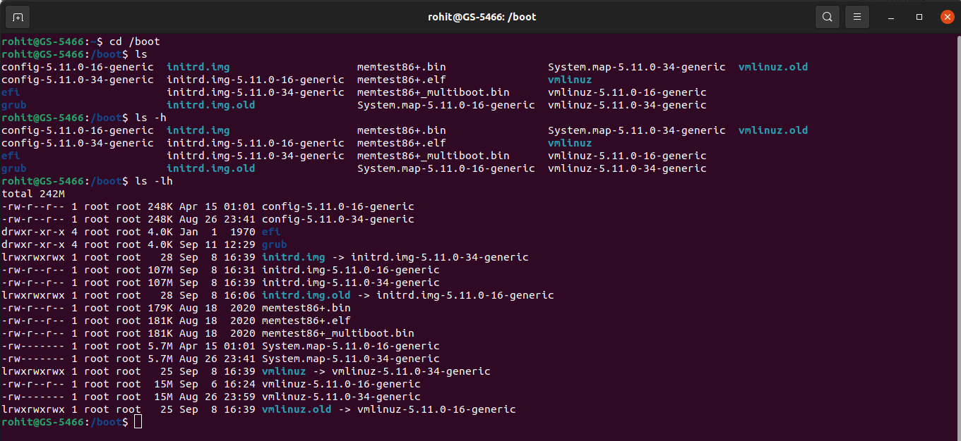

Slide 11
5.Display the first 12 lines of /etc/services.
Head command is used to print first few lines from a specified file.
If you want to print n lines specifically,mention -n in command.
Ex:head -12 /etc/services

Slide 12
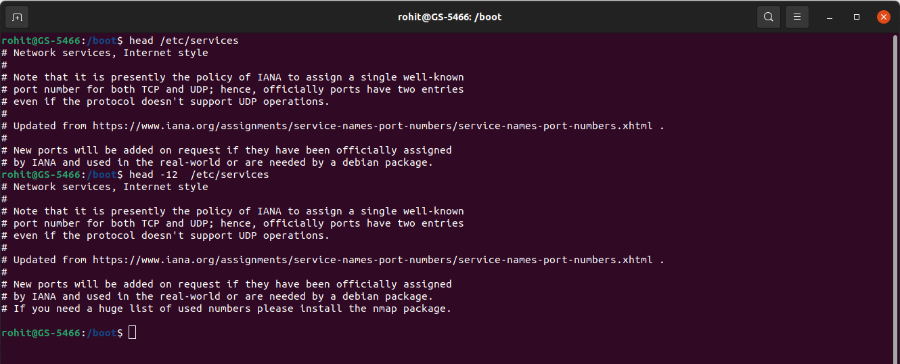

Slide 13
6.Display the last line of /etc/passwd
Tail command is used to print last few lines from a specified file.
To print n lines specifically,mention -n in command.
Ex:tail -1 /etc/passwd

Slide 14
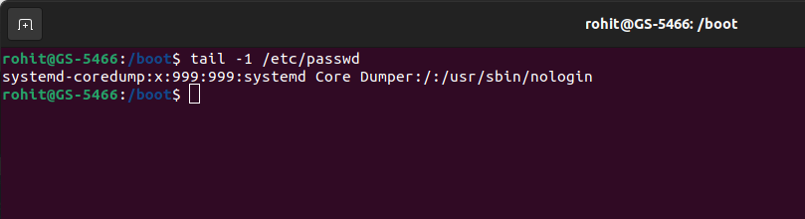

Slide 15
7. List the partition types and print the partition table.
Lsblk command is used to print partition table of the system.
Fdisk command returns list of partitions.

Slide 16
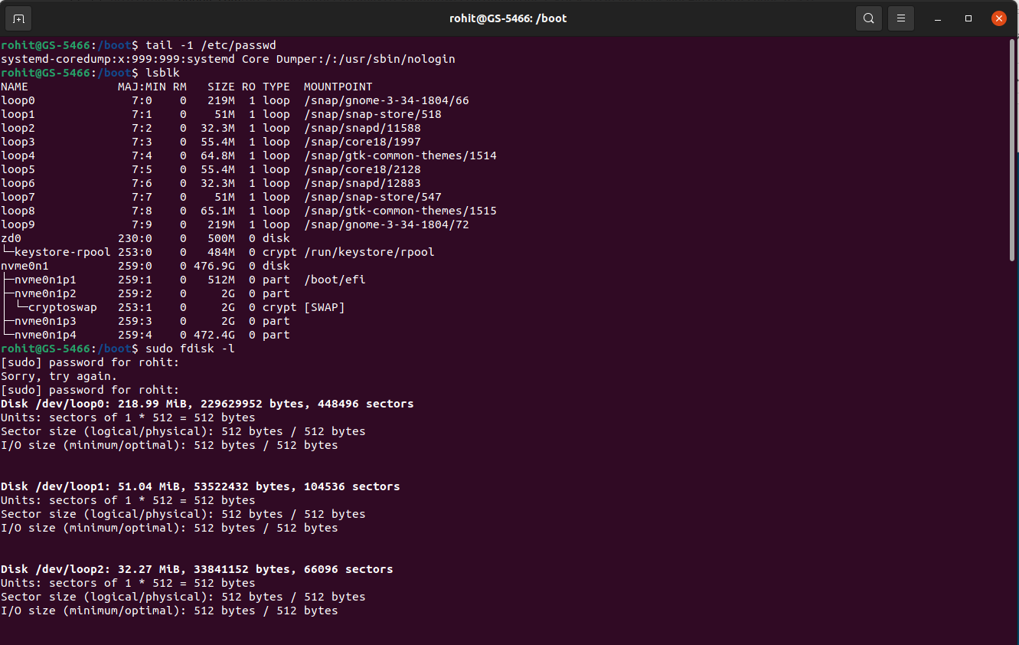

Slide 17
8. Create a new group. Create a new user along with specifying a password for it. Add this new
user to the new group created and print these details for verification.
Sudo usermod command is used to add user in an existing group.-a -G flags are used in command.
Syntax:sudo usermod -a -G groupname username.
Options:
-a:add user in a group.
-G:specifies the name of secondary group name in which we want to add an user.

Slide 18
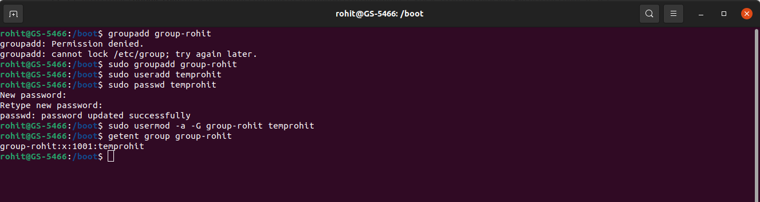

Slide 19
9. Locate the daemons running on the system.
A daemon is a long-running process which answers requests for services.
To print currently running daemons,use command services --status-all.

Slide 20
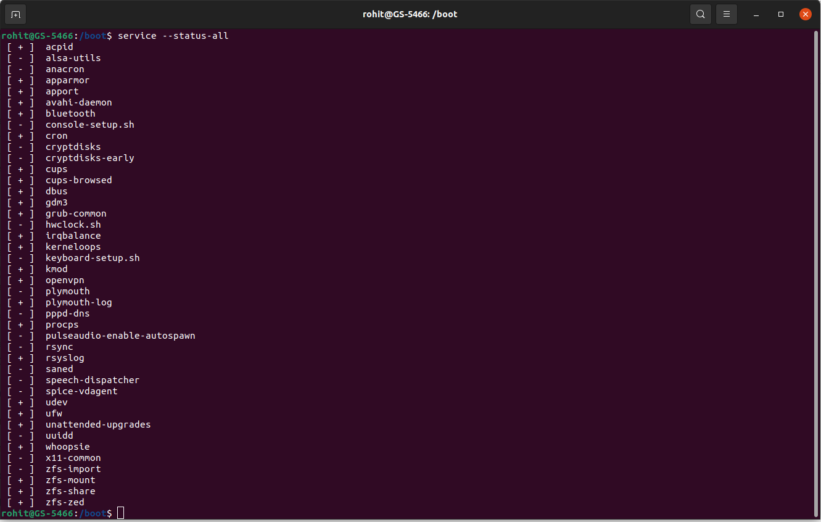

Slide 21
10.Display A B C with two spaces between B and C.
For this statement,use echo command to print desired output.
Ex:echo “A B C”

Slide 22
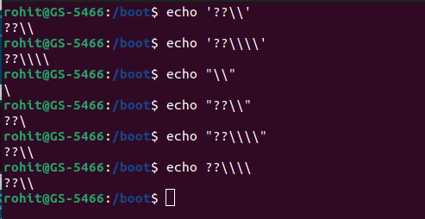
11. Use echo to display the following exactly:??\\

Slide 23
Write a command that executes rm file55. Your command line should print 'success' if file55 is
removed, and print 'failed' if there was a problem
This statement checks knowledge of piping in linux.here use rm command to delete file.use and operator to print decisions.
If file deleted successfully,echo “success” else print “failed”.

Slide 24
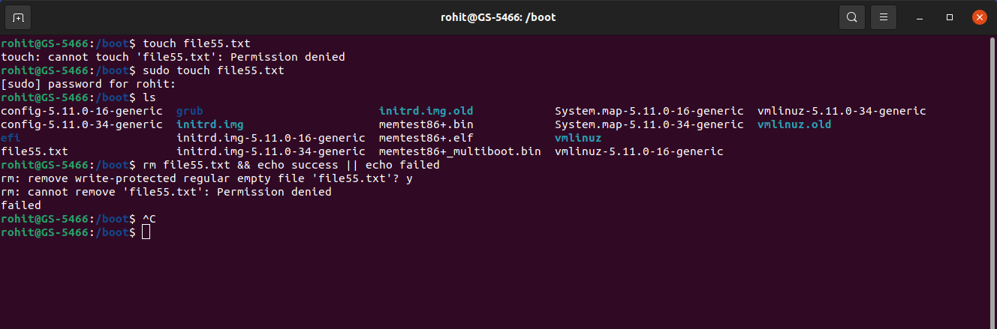

Slide 25
13.Create a script which takes ‘String’ type input from user and prints the number of lines, words
and characters in it. Any input other than ‘String’ type, should result in an error.
Wc command is used to count lines,words and characters in an specified file.
It prints lineCount,wordCount and character count and file name.

Slide 26
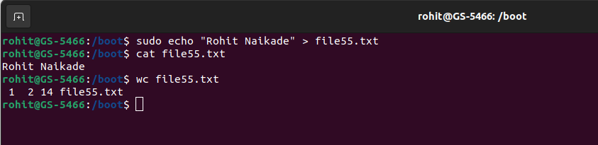

Slide 27
14.Create a file with 10-15 lines of text and perform the following operations-
a. Replaces first occurrence of the with THE on every line of the file
b. Replaces every occurrence of & (escaped) with "and"
c. Put a # at the beginning of lines 5 through 10
d. Do a "grep'' to find lines containing the word ‘a', then delete them

Slide 28
a.Replaces first occurrence of the with THE on every line of the file
Sed utility provides facility to replace contents of file.
Options:
1)-i:perform in-place changes in a file.
2)g:perform changes in whole file instead of replacing first occurrence.
Syntax: sudo sed -i ‘s/old_owrd/new_word/’ filename

Slide 29
b.Replaces every occurrence of & (escaped) with "and"
Sed utility provides facility to replace contents of file.
Options:
1)-i:perform in-place changes in a file.
2)g:perform changes in whole file instead of replacing first occurrence.
Syntax: sudo sed -i ‘s/old_owrd/new_word/’ filename

Slide 30
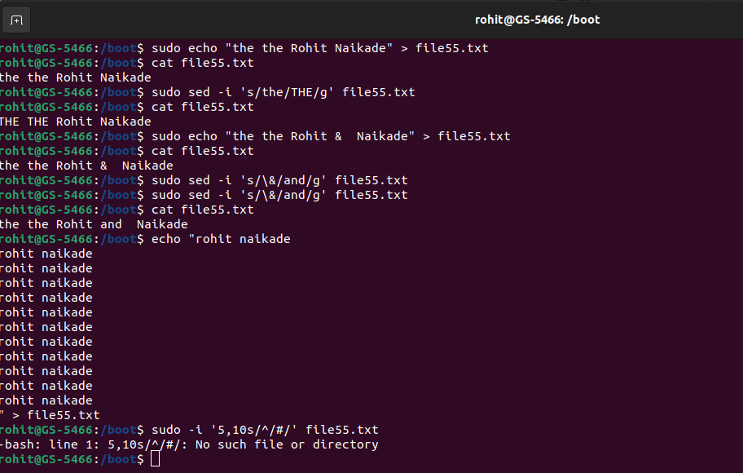

Slide 31
c.Put a # at the beginning of lines 5 through 10.
Sed utility provides facility to add contents in the start or end of the line of file.
Syntax:
Sudo sed -i ‘start,end s/^/<addContent>/’ filename

Slide 32
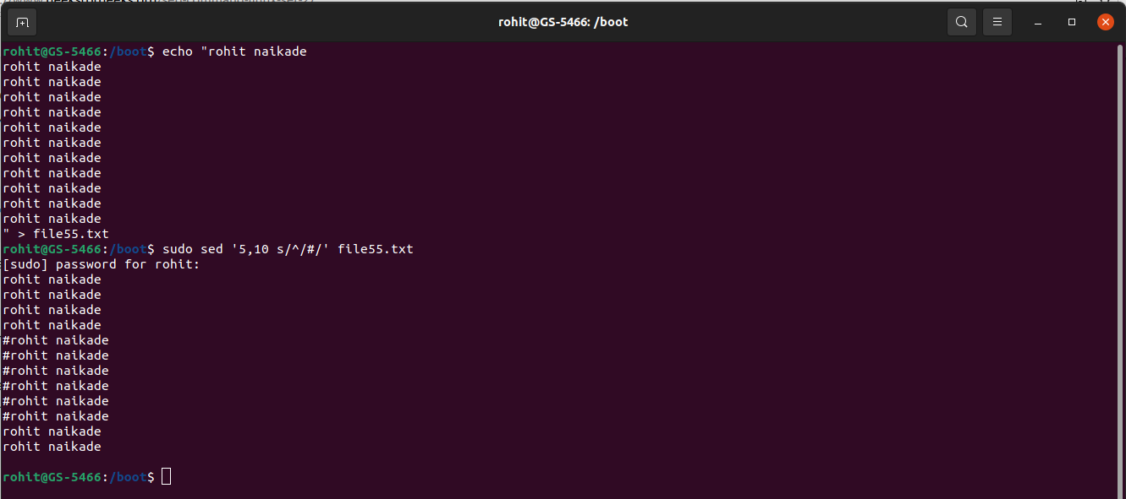

Slide 33
d. Do a "grep'' to find lines containing the word ‘a', then delete them
Grep command provides facility to find words in a file.-v option of grep provide facility to exclude lines which contains matched words.
Syntax:grep -v “matchingWord” srcFile destFile

Slide 34
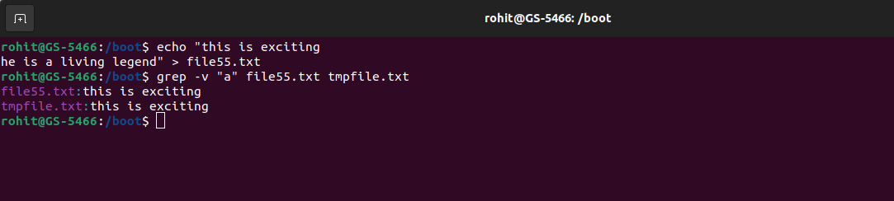

Slide 35
15. Install a libvirt/python package on your machine
Apt-get package manager is used to install packages in linux.

Slide 36
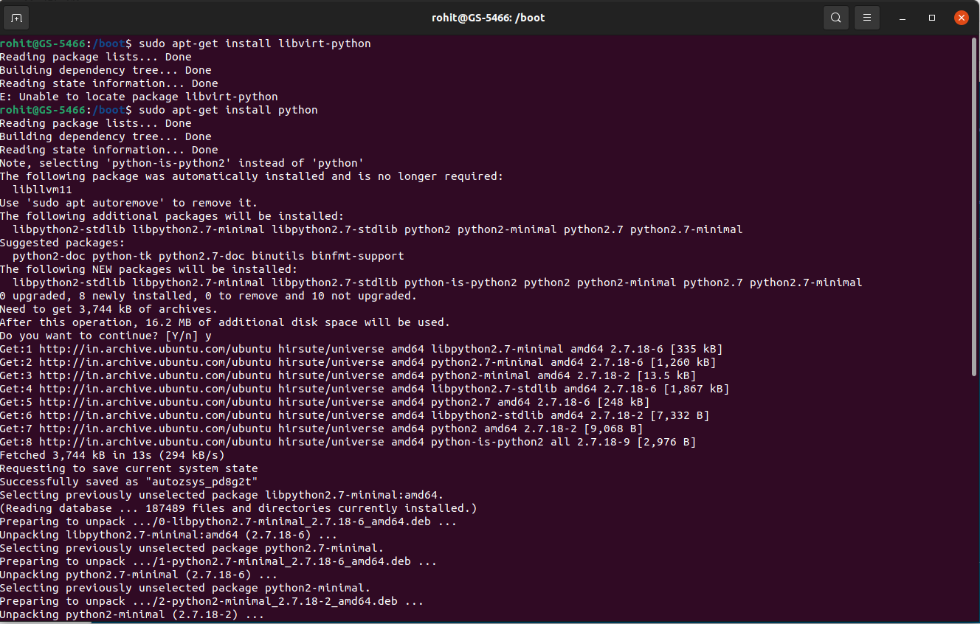

Slide 37
16. Download the file using command line:
Wget command provides functionality to download file from specified URL.
Syntax:wget <url> -o <localapth>

Slide 38
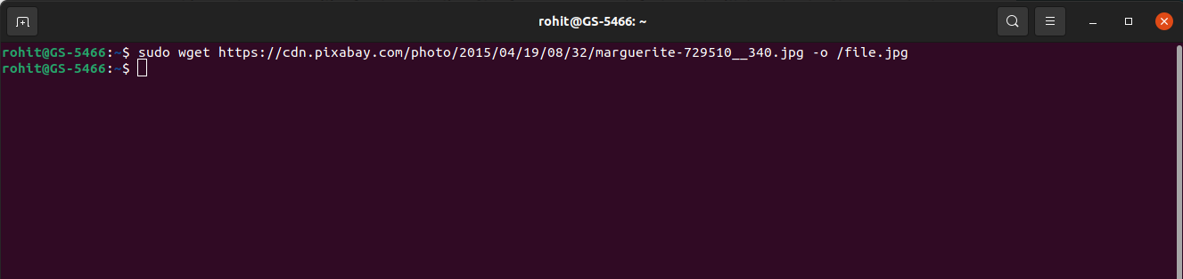

Slide 39
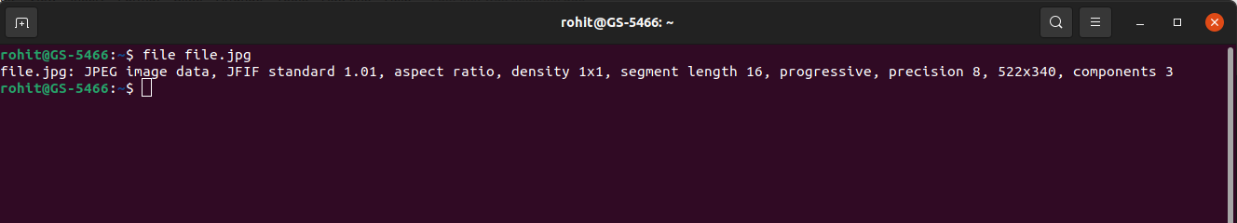
Display the type of file.
File command of linux provides facility to determine type of specified file.
Syntax:file filename

Slide 40
18.You receive information that one of your servers was cracked, the cracker probably replaced the
ls command. You know that the echo command is safe to use. Can echo replace ls ? How can
you list the files in the current directory with echo ?

Slide 41
This problem can be resolved by shell script.we can loop through file names in a file and print them using echo command.
For entry in ‘$boot’/*
Do
Echo “$entry”
done

Slide 42
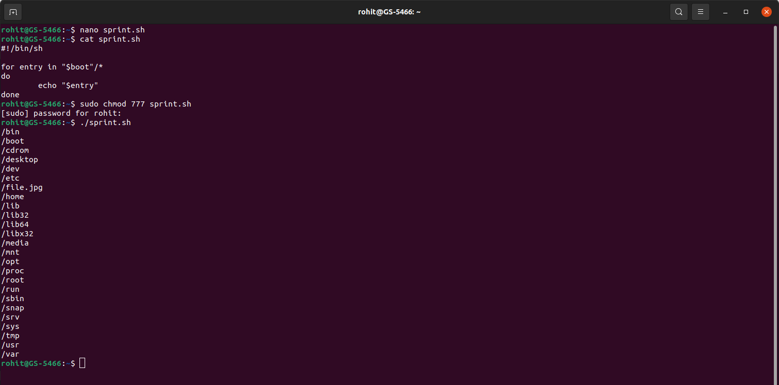

Slide 43
19.Put a sorted list of all bash users in bashusers.txt.
To accomplish this task,firstly get currently logged in users using w command and store it into bashusers.txt file.
Then,sort file contents using sort filename command.
Ex:w > bashusers.txt
Sort bashusers.txt

Slide 44
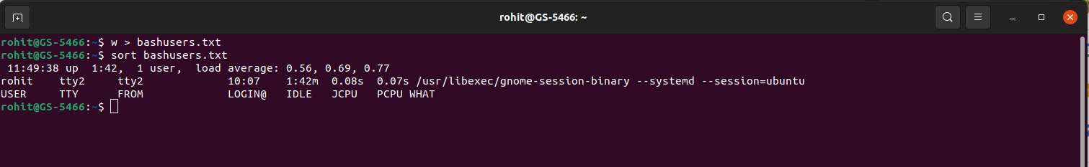

Slide 45
20.Look at the output of /sbin/ifconfig. Write a line that displays only ip address and the subnet
mask.
Here,grep command will be handy.firstly read content from file and using pipe operator,use grep command to filter output.
ex:/sbin/ifconfig | grep -w “inet”

